Slide 1


Scaling the Superapp: How Revolut Grew Globally through Strategic Product Expansion
A Case Study by: Suhani Patel
June 2025

Slide 2

Agenda
Introduction
The challenge
User Personas
Product Strategy Overview
Competitive Benchmarking
Global Reach, Local Roots: Revolut’s Expansion Playbook
Outcomes and Impacts
Learnings and strategic takeaways
References
Let’s connect!

Slide 3

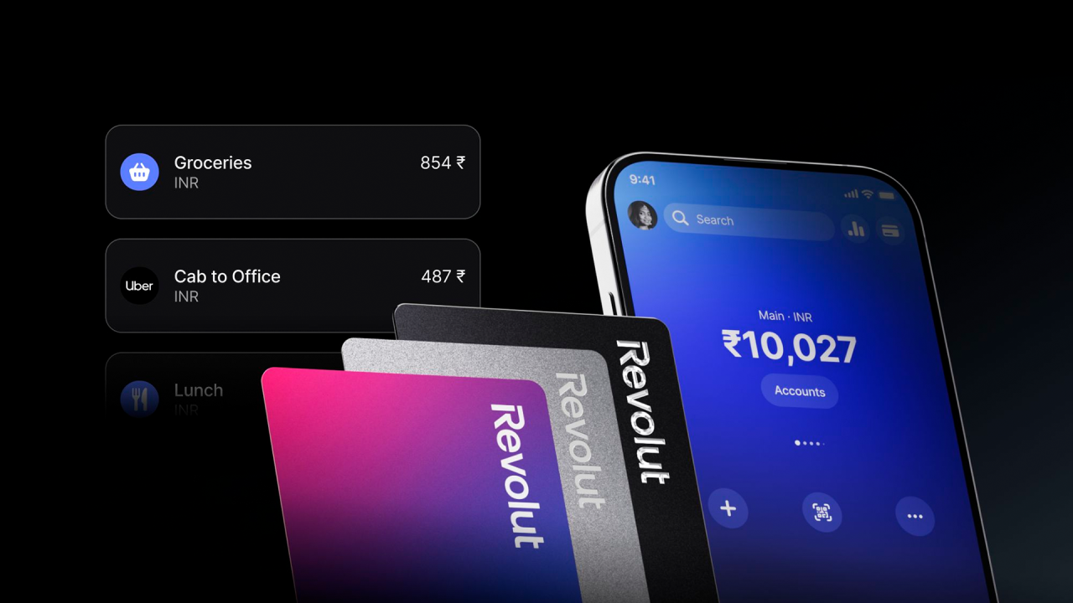
Back to Agenda
Introduction
Founded in 2015 as a prepaid FX travel card app
Now a global financial superapp: crypto, stocks, business tools, vaults, etc.
40M+ users | 35+ countries | $33B+ valuation
Added budgeting, P2P payments, crypto trading
2017
Entered US, Australia, Asia, LATAM
2019-21
France, Paris becomes Western HQ
2025
2015
Launched in UK
2018
Secured European banking license (Lithuania)
2022
25M+ users,
330M+ transactions/month

Slide 4

The Challenge
Back to Agenda
Problem Statement:
“How can a fintech startup like Revolut scale globally while navigating diverse regulatory environments, localizing its product for varied user behaviors, and maintaining a sustainable, unified operational model — all without compromising speed, innovation, or user experience?”
Key Globalization Challenges:
Regulatory fragmentation & licensing
Financial behaviors differ by region (e.g., UPI, cash-based vs. card-based)
High CAC in mature fintech markets
Need for unified product identity across local adaptations

Slide 5


User Personas
Back to Agenda
Goals: Manage multiple currencies Send/receive money instantly Track spending across countries Pain Points: High bank fees for exchange/transfers Hard to manage cross-border finances Slow, unclear customer support How Revolut Helps: Real-time multi-currency accounts Instant P2P & bill splitting Budgeting & spending insights | Goals: Manage money between India & Germany Receive funds from family affordably Pay tuition/rent in euros Build credit history Pain Points: Costly, slow international transfers Hard to open local accounts Tracking multi-currency spending How Revolut Helps: Easy sign-up, minimal docs Fast, low-cost INR↔EUR transfers Multi-currency wallet Budgeting tools, virtual/physical cards
EMMA - The Global Freelancer
Age - 28
Occupation - Remote digital marketer
Location: London; travels Europe & Asia
RAJ- International Student
Age - 20
Occupation - Grad Student, Germany
Origin - India

Slide 6
Product Strategy Overview
Back to Agenda
Pillar 1
Core Utility First
Pillar 2
Vertical Stack Expansion
Pillar 3
Platform Thinking & Embedded Finance
Pillar 4
Agile Tech + Data-Driven Experiments
Insight: Start with a high-frequency, high-friction use case to build habit.
Launched with FX transfers and multi-currency accounts
Solved pain points: high forex fees, poor UX in traditional banks
Acted as the hook to onboard users
Rapid word-of-mouth growth due to tangible savings
Insight: Build APIs + infrastructure to enable others
Launch of Revolut Business: Embedded accounts, cards, payroll
API-based FX and payment services for SMEs
Junior & Family: Embedded finance within families
Donations: API integrations with charities
Platform > Product
Insight: Product-led growth enabled by internal tech and rapid iteration
100+ microservices enable fast A/B testing
Features built → tested → killed or scaled within weeks
Custom risk engine for fraud, lending, and compliance
Growth loops fueled by in-app referrals, gamified onboarding
Insight: Add deeply integrated financial tools within the same user journey
Key additions:
Invest(Crypto, Stocks)
Spend (Cards, Budgeting, Rewards)
Insure (Travel, Health)
Save (Vaults, Sub-Accounts)
Earn (Salary, Interest, Subscriptions)
Benefits:
Cross-selling becomes natural
Enhances Lifetime Value (LTV)

Slide 7

Global Reach, Local Roots: Revolut’s Expansion Playbook
Back to Agenda
EU - SEPA integration, salary advance, IBANs
Global Expansion Strategy:
Phased market entry: UK → EU → US → APAC
Criteria: Regulatory readiness, digital banking gaps, cross-border financial needs
Unified backend with regional rollouts
Operational Scaling:
Cloud-native infra for modular scaling
Country-specific legal entities (e.g., EU e-money license, US partnerships)
24/7 multilingual support + decentralized ops hubs
US - Crypto + stock, limited banking
Japan - Prepaid cards, minimalist UI
India - UPI & wallet plans in progress (regulatory)

Slide 8

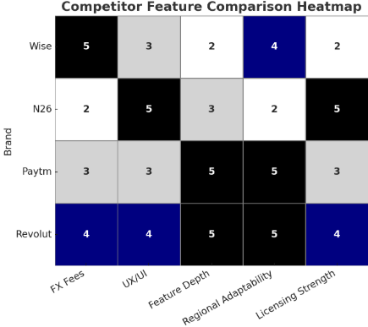
Competitive Benchmarking
Back to Agenda
Global Fintech Landscape (2025–2030):
Market Size: Projected to reach $1.5T by 2030 (BCG, QED, Finextra).
Regions: APAC (fastest growth), North America, Europe.
Segments: Payments, neobanking, remittances, FX, crypto, wealth, B2B2X.
Revolut’s Positioning:
Users: 40M+ users, 150+ countries.
Products: Multi-currency wallet, crypto, stocks, travel insurance, budgeting.
Licenses: E-money institution, expanding full banking licenses.

Slide 9
Back to Agenda
Outcomes & Impact
Global Reach: 40M+ users, 150+ countries
Product Breadth: 50+ services across banking, crypto, insurance, investments
Innovation Speed: Weekly feature rollouts across geographies
Revenue Growth: $1B+ annualized revenue (2023–24 estimate)
Brand Equity: Positioned as Europe’s most valuable neobank

Slide 10

Back to Agenda
Learnings & Strategic Takeaways
Tailor product to market, not just language
Start with real user pain
Localized Execution
Core Utility
Ecosystems build competitive moats
Platform Thinking
Vertical Stack
Deep > wide for long-term retention
Agile Infrastructure
Test fast, kill faster, scale fastest

Slide 11

Back to Agenda
References
Revolut annual report 2022
Revolut annual report 2023
Revolut annual report 2024
contrary research
Revolut Revolution: by Pawel Rybacki

Slide 12

Back to Agenda
Let’s Connect!
Name: Suhani Patel
Role: Product + FinTech Enthusiast | CS + FinTech @ MIT Manipal
Email: suhanip1903@gmail.com
LinkedIn: linkedin.com/in/suhani-patel-a6957a250

